Slide 1
Introduction TO HTML
Introduction to web design bootcamp – University of Limerick

Slide 2
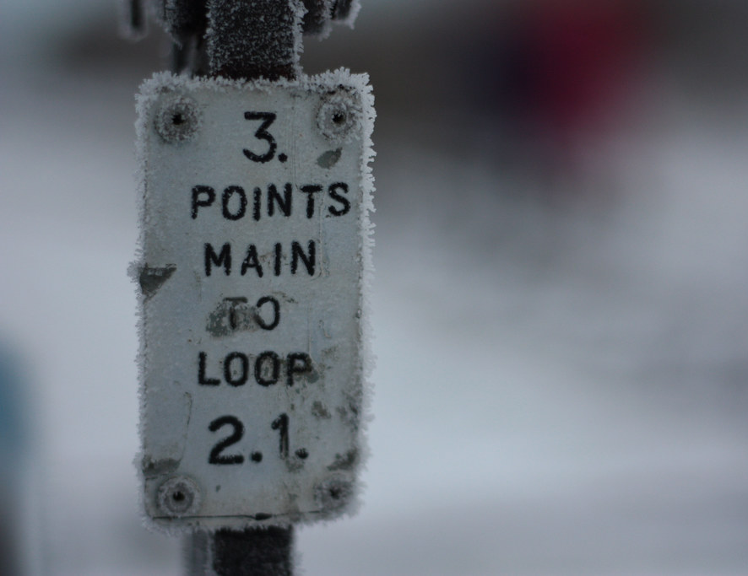
Main Points
The Basic Rules
The 4 required tags
The boilerplate
How/where to save
This Photo by Unknown Author is licensed under CC BY-SA

Slide 3
The boilerplate
<!DOCTYPE html>
<html>
<head>
<title>My first Webpage</title>
</head>
<body>
My content goes here. It can be just text or I can add other HTML tags
</body>
</html>

Slide 4
The Basic Rules
A webpage is a simple text document (no formatting) with a file extension of .html
It can be written using any simple text editor
It is made up of tags that come in pairs – an opening and closing tag (with 4 exceptions that we will discuss later)
<tagname> content here </tagname>

Slide 5
The 4 required tags
There are 4 required tags to describe a document. These are:
html – indicates that this is a HTML document
title – gives the title of the webpage
head – is used for formatting rules
body – is used for the content
In addition, it is recommended to put in a doctype to indicate what version of HTML you are using.

Slide 6
How/where to save
The text is saved using the extension .html
The first page of a site (the homepage) is generally named index.html
For now we will save the html documents to the desktop
In practice, these files are saved in a particular folder on a webserver.
Once it’s saved, double click on the icon on your desktop to open your file in the browser

